Slide 1
CGI – Common Gateway Interface

Slide 2
Need for CGI
HTML/XHTML is static, it is not parameterized;
using only HTML/XHTML, CSS and JS one can not write dynamic web pages: pages that look differently depending on the user who visit it (client, administrator etc.), pages that display different products depending on what is in a database, pages that should be displayed depending on the value of some parameters.
using only HTML/XHTML, CSS and JS one can not develop distributed web applications (e-commerce sites, hotel booking, web search applications etc.)

Slide 3
What is CGI?
a standard protocol for interfacing external application software with the web server
developed in 1993 at NCSA (National Center for Supercomputing Applications)
CGI 1.1 specified in RFC 3875, 2004
allows an external executable file to respond to an HTTP Request from the browser
CGI defines how information is passed from the web server to the executable program and how information is passed from this back to the server

Slide 4

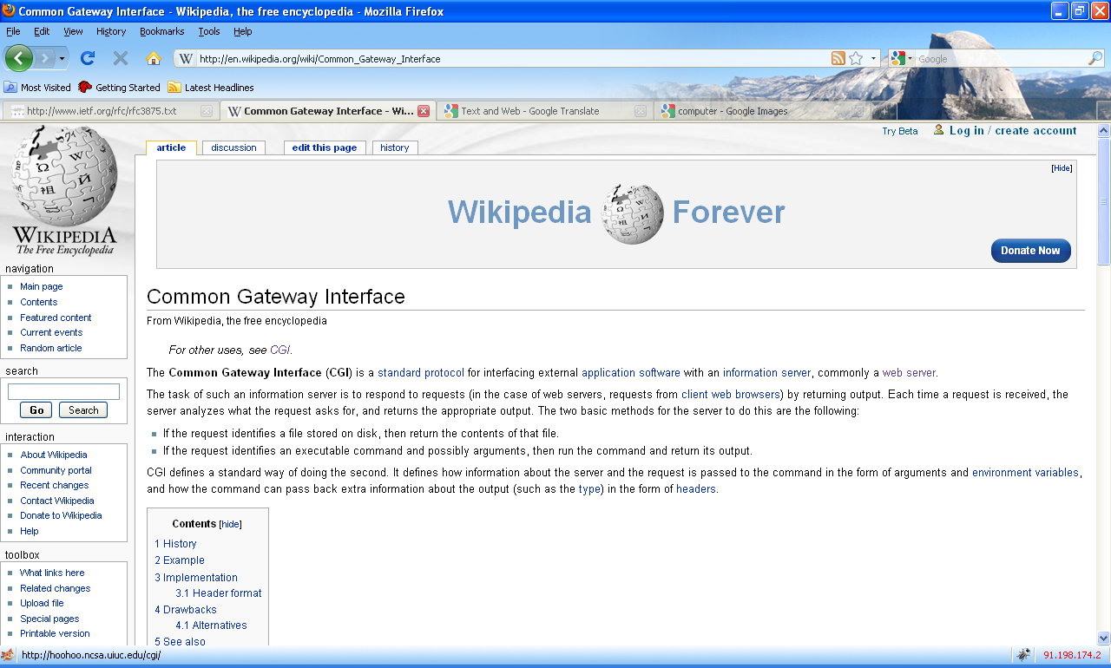
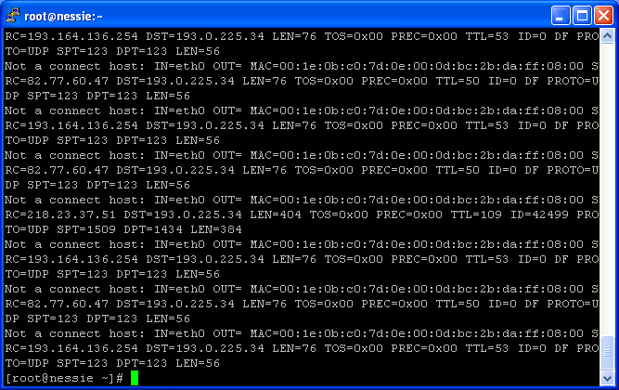
Server-side web programming
the HTTP Response consists of the output of an exernal program located on the server machine:
HTTP Request
Server-side Request
HTTP Response
Response Header +
Html file
browser
web server
executable file/CGI,
php file, jsp file, asp
file

Slide 5
Drawbacks of CGI
because no special web-oriented language is used for writing CGI scripts (e.g. shell, perl, c/c++, python etc.) errors are highly probable and so, security vulnerabilities due to these problems
usually a new process is created for each run of a CGI script; this increases the load on the server
CGI scripts are executable file; they can write/delete from the local disk, so this is a security vulnerability

Slide 6
First CGI example (in shell)
#!/bin/bash
echo Status: 200 OK
echo Content-Type: text/html
echo
echo
echo "<html><head></head>"
echo "<body>"
echo "Hello world."
echo "</body></html>"

Slide 7
Getting parameters from the client/browser
parameters can be passed from the user to the CGI script through an html <form>
<form action=“script.cgi” method=“GET | POST”>
<input type=“…” name=“input1” />
<input type=“…” name=“input2” />
…
<input type=“…” name=“inputN” />
</form>
the script.cgi will get the parameters as:
input1=val1&input2=val2& … &inputN=valN

Slide 8
Getting parameters from the client/browser (2)
parameters can be sent through the GET method (in the HTTP Request header) => the CGI script will receive the parameters from the web server in an environment variable $QUERY_STRING
or they can be passed through the POST method (in the body of the HTTP Request) => the CGI script will receive the parameters from the web server in the standard input

Slide 9
Form example
<html>
<head></head>
<body>
<form action="cgi-bin/post_ex.cgi" method="POST">
User: <input type="text" size="20" name="user" /><br />
Password: <input type="text" size="20" name="pass" /><br />
<input type="submit" value="Submit" name="submit" />
</form>
</body>
</html>

Slide 10
Getting parameters through GET
#!/bin/bash
echo "Content-Type: text/html"
echo
echo
echo "<html><head></head>"
echo "<body>"
echo "Parameters are:<br />"
user=`echo $QUERY_STRING | cut -d"&" -f 1 | cut -d"=" -f 2`
pass=`echo $QUERY_STRING | cut -d"&" -f 2 | cut -d"=" -f 2`
echo $user $pass
echo "</body></html>"

Slide 11
Getting parameters through POST
#include <stdio.h>
#include <string.h>
main() {
char line[255], *userline, *passline, *s;
char user[20], pass[20];
printf("Content-Type: text/html\n\n");
printf("<html><head></head>");
printf("<body>");
fgets(line, 255, stdin);
printf("Parameters are: <br />");
userline = strtok(line, "&");
passline = strtok(0, "&");
user[0] = 0;
if (userline) {
s = strtok(userline, "=");
s = strtok(0, "=");
if (s) strcpy(user, s);
}
pass[0] = 0;
if (passline) {
s = strtok(passline, "=");
s = strtok(0, "=");
if (s) strcpy(pass, s);
}
printf("%s, %s", user, pass);
printf("</body>");
printf("</html>");
}

Slide 12
Apache relevant configuration lines
loading the CGI module:
LoadModule cgi_module modules/mod_cgi.so
adding a CGI handler:
AddHandler cgi-script .cgi
describing properties for the CGI directory
<Directory /home/*/*/*/cgi-bin>
Options ExecCGI
</Directory>

Slide 13
CGI script names and locations
a CGI script must be an executable file (have “x” rights) and must have the .cgi extension
the CGI script must be placed in the cgi-bin directory in the public_html directory of the user

Slide 14
The Apache web server
…

